Slide 1

Expecto Patronum
sed
grep
scp
dircmp
tar
crontab
fortune | cowsay
(or How I Learned to Stop Worrying and Love the Command Line)
Charles Jackson
Pacific Northwest Drupal Summit
February 2018

Slide 2

Charles Jackson
Senior Web Manager
Fujifilm SonoSite
Since 1985, I’ve built tools on BSD 4.13, Unix SVR4, Solaris 2 through 11, AIX, Linux, Darwin, Irix, Compuserve GIS, and Atari DOS/TOS command-line systems.

Slide 3


Fujifilm SonoSite is the global leader in
point-of-care ultrasound.
We self-host a suite of Drupal-based
product sites, educational sites, and
web-based apps.

Slide 4

Before we begin, you should know how to do this:
Log-in to a Linux system using ssh, PuTTY, etc.
Move between directories (cd)
Edit a simple text file (vim, emacs, or other)
Create & use file and database backups

Slide 5

But if you don't know any of that, these links will get you started:
http://www.ee.surrey.ac.uk/Teaching/Unix/unix1.html
https://www.liquidweb.com/kb/new-user-tutorial-basic-ssh/
https://ryanstutorials.net/linuxtutorial/vi.php

Slide 6

The Command Line –
- - - So Why Bother???
When an interface can't
(or won't)
do everything we need…

Slide 7

The Command Line –
- - - So Why Bother???
…it may be necessary to
go around that interface

Slide 8



Strange-sounding, hard-to-pronounce words and phrases
Amazingly powerful (and amazingly dangerous)
Ancient, seldom-changed texts, authored by wizards with long hair and beards
No wizard knows all of it
Pretty scary to muggles and mortals
Notes:
Original UNIX manual written in 1970. The basic commands have been unchanged in 50 years.

Slide 9

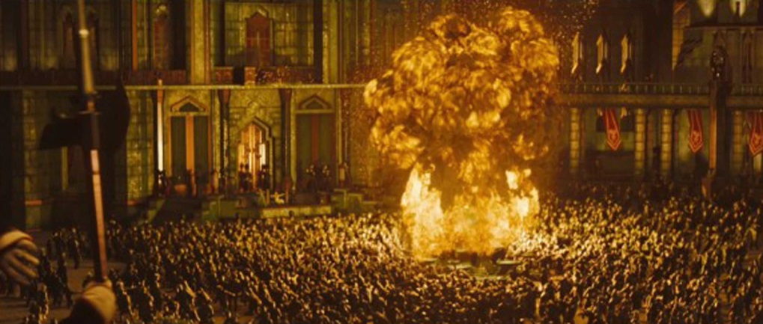
Safety First
Practice in a sandbox, scratch directory, or other non-critical area
Have a recovery plan
Backups are your friend
Anything that can blow-up probably will. Be Prepared.
Notes:
Original UNIX manual written in 1970. The basic commands have been unchanged in 50 years.

Slide 10

cat
"concatenate"
Display the contents of one or more text files: cat settings.php cat *.html cat one.txt two.txt
Concatenate files: cat *.pdf > all_in_one.pdf

Slide 11

Redirection
> Write the output of a command to a file: date > my_date_file.txt
my_date_file.txt now contains the string:
Thu Dec 28 11:13:57 PST 2017

Slide 12
Redirection
>>
Same as before, but append to a file: echo "hello world" >> my_date_file.txt
Thu Dec 28 11:13:57 PST 2017
hello world

Slide 13
Redirection
|
Pass output from one command to another:
cat log.txt | mail –s "Logs" it@hogwarts.edu
ls -1 /tmp/* | sort -–ignore-case > sorted.txt
ls -1R sites/default/files | wc –l
ls –lt | more

Slide 14
Bash Aliases
Macros for Linux. Add them to your .bashrc file.
# Safety Nets
alias rm='rm –i'
alias mv='mv –i'
alias cp='cp –i'
alias dc='cd'

Slide 15
Bash Aliases
Macros for Linux. Add them to your .bashrc file.
# Tools
alias numusr='netstat -an |egrep "443|80" |wc -l'
alias h='history'
alias cpuinfo='lscpu'

Slide 16
Bash Aliases - numusr
Macros for Linux. Add them to your .bashrc file.
# Tools
alias numusr='netstat -an |egrep "443|80" |wc -l'
Example:
numusr
76
Notes:
How many network connections are on Port 443 and 80

Slide 17
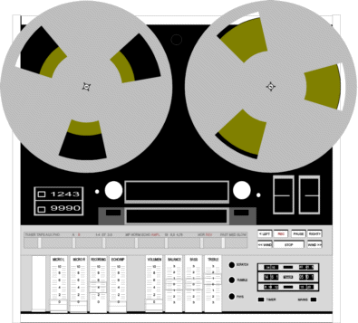
Bash Aliases - history
Macros for Linux. Add them to your .bashrc file.
# Tools
alias h='history'
Records and plays back what you did (and what other users have done)

Slide 18
Bash Aliases - history
Macros for Linux. Add them to your .bashrc file.
Example:
h
8924 [2017-12-28 16:29:49] meminfo
8925 [2017-12-28 16:52:41] dircmp d_one d_two
8926 [2017-12-28 17:04:56] more .bashrc
8927 [2017-12-28 17:05:49] ls /tmp
8928 [2017-12-28 17:34:08] history
!! repeats the previous command
!8927 repeats command 8927 Up/Down Arrows to scroll

Slide 19
Bash Aliases - cpuinfo
Macros for Linux. Add them to your .bashrc file.
# Tools
alias cpuinfo='lscpu'
Example:
lscpu Architecture: x86_64
CPU op-mode(s): 32-bit, 64-bit
Byte Order: Little Endian
CPU(s): 10
On-line CPU(s) list: 0-9
Thread(s) per core: 1
Core(s) per socket: 1
Socket(s): 10
NUMA node(s): 2
Vendor ID: GenuineIntel
and lots lots more . . .

Slide 20
Bash Functions – dos2unix
May also be added to your .bashrc file
# Convert MS-DOS line endings to Unix
dos2unix() { cat $1 | tr -d '\015' > $2 ;}
Example:
dos2unix default.htm index.html
Existing MS-DOS file New Unix file

Slide 21

Bash Functions - dircmp
May also be added to your .bashrc file
# Recursively compare two directories
dircmp() { diff -qr $1 $2 ;}
Example with directories called foo and bar:
dircmp foo bar
Only in bar: file.bin
Only in foo: hello.txt
Files foo/name.txt and bar/name.txt differ
(only the differences are printed)

Slide 22
Bash Functions - dircmpdiff
May also be added to your .bashrc file
# dircmp, in diff format:
dircmpdiff(){ diff -q -r $1 $2 | \
sed 's/^Files /diff /g;s/ and / /g;s/differ$//g' ;}
Example:
dircmpdiff foo bar
Only in bar: file.bin
Only in foo: hello.txt
diff foo/name.txt bar/name.txt

Slide 23
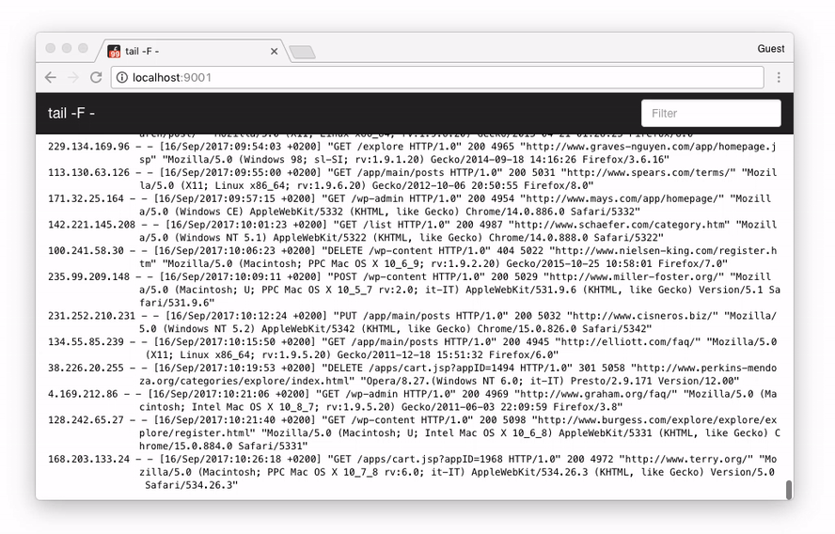
Real-time logfile monitors
First, find your logfiles . . .
cd /var/log/httpd or cd /var/log/nginx
Example 1:
tail –f access_log
Displays a realtime scrolling display of
the access_log file, as it is being written.

Slide 24
Real-time logfile monitors
Example 2:
tail –f access_log SSL_access_log
Displays a realtime scrolling list of the last few lines of the
the named files, as they are being written.

Slide 25
Real-time logfile monitors
Example 3:
tail –f access_log | grep –i Googlebot
Only show lines containing Googlebot (case-insensitive)
in the scrolling display.

Slide 26

Where Is That String?
"It's either in a file
or it's in the database"
How to search both

Slide 27

grep g/re/p – global search for regular expression and print
Case-sensitive search through one or
more text files for a string, and then show
all the lines that contain that string
Example 1:
Search the current Apache log for an IP address:
grep 51.255.71.120 access.log
51.255.71.120 - - [28/Dec/2017:03:43:04 -0800] "GET...
51.255.71.120 - - [28/Dec/2017:05:37:33 -0800] "GET...
51.255.71.120 - - [28/Dec/2017:06:15:00 -0800] "GET...

Slide 28
grep
Example 2:
Search all logs (in the current directory) for an IP address:
grep 51.255.71.120 *.log
son1_access.log:51.255.71.120 - - [28/Dec/2017:03...
son2_access.log:51.255.71.120 - - [28/Dec/2017:05...
son0_access.log:51.255.71.120 - - [28/Dec/2017:06...

Slide 29
grep compressed files
zgrep and bzgrep
Search all compressed logs
in the current directory
Example:
bzgrep 51.255.71.120 *.bz2 > /tmp/srch1.log
zgrep 51.255.71.120 *.gz > /tmp/srch2.log
son1.log-209.bz2:51.255.71.120 - - [18/Nov/2017:22:47:54 -0800] "GET /ja/bl . . .
vis2.log-119.bz2:51.255.71.120 - - [18/Nov/2017:23:58:22 -0800] "GET /it/pr . . .
vis2.log-219.bz2:51.255.71.120 - - [19/Nov/2017:03:03:55 -0800] "GET /kr/nb . . .

Slide 30

Recursive grep
Search for a string in any file at
or beneath the current directory
cd sites/all/modules/custom
grep –rin some_unique_reference
-r = Recursive search
-i = Case-insensitive
-n = Print line numbers
TIP:
Make a shortcut alias with:
alias grin='grep –rin'

Slide 31
grep the MySQL database
No luck with recursive string searches?
Here's how to grep your database.
Download and configure the dumpXMLtables.php script, https://github.com/nightbeacons/Expecto_Patronum
Run dumpXMLtables.php. It writes an XML file for each table in your db. (users.xml, watchdog.xml, . . .)

Slide 32
grep the MySQL database
3. grep -i for your target string. (Tip: If you get a large search result, redirect the output to a file.)
The grep shows the table name (as the name of the XML file)
as well as the column name and the target string.

Slide 33
grep the MySQL database
Example:
grep drupal *.xml
actions.xml: <field name="callback">node_export_drupal…
advagg_files.xml: <field name="filename">misc/drupal.js…
locales_source.xml: <field name="source">drupal name for…
table name column name

Slide 34

dumpXMLtables and dircmp
very useful for very broken sites
Run dumpXMLtables.php to create a "before" snapshot of the database. Rename the dump directory before_xml

Slide 35

dumpXMLtables and dircmp
very useful for very broken sites
2. In Drupal, change just one thing.
(Typically this will be your "prime suspect" component.)

Slide 36

dumpXMLtables and dircmp
very useful for very broken sites
3. Re-run dumpXMLtables.php to create an "after" snapshot.
Rename that dump directory after_xml

Slide 37

dumpXMLtables and dircmp
very useful for very broken sites
4. Use dircmp before_xml after_xml to discover all changes to the database.
(Tip: Or use dircmpdiff for copy/paste ability)

Slide 38

Manipulating Images
using convert, from imagemagick.org
If you can do it with Photoshop (or gimp), you can do it faster with convert:
Convert between formats (JPG, PNG, GIF, SVG . . .)
Resize, rotate, and optimize images
Make animated GIFs and sprites
Adjust colors, apply special effects, draw shapes, and master time, space, and dimension

Slide 39
convert: Basic Examples
convert banner.jpg banner.png
convert –geometry 50% big.jpg small.gif
convert –quality 51% orig.jpg opti.jpg
convert --help | more

Slide 40

convert: Power Tools
Example 1:
convert –delay 20 –loop 0 cradle*.gif \
animated_cradle.gif
Notes:
Example #1: Create an animated dog GIF, with 20/100ths of a second delay between frames, looping forever

Slide 41
convert: Power Tools
Example 2:
convert –colorspace Gray fullcolor.jpg \
monochrome.png
Example 3:
curl –s http://pnw.org/banner.jpg \
| - convert –resize 200% my.png
Notes:
Example #1: Create an animated dog GIF, with 20/100ths of a second delay between frames, looping forever
Example #2: Create a monochrome PNG version of a full-color JPG
Example #3: Fetch a banner from a web site, double its size and save it as a PNG

Slide 42
Sending email
Using the mail command
Example 1:
echo "This is the body of the email" \
| mail -s "The Subject" foo@bar.com

Slide 43
Sending email
Using the mail command
Example 2:
cat /tmp/msg.txt | \
| mail –s "Another One" foo@bar.com

Slide 44
Sending email
Adding an attachment
Example 3:
echo "Attachment attached" \
| mail –s "With Attachment" \
| -a /var/www/image.png foo@bar.com

Slide 45

scp
"secure copy"
Quickly copy files between systems (You need a valid login on both systems)
Send a local file to a remote system:
scp myfile.txt harryp@hgwrt1.edu:/var/www
Fetch multiple files from a remote system:
scp harryp@hgwrt1.edu:/tmp/images/*.jpg \ /var/www/images

Slide 46
scp: Power Tools
Send an entire directory to a remote system:
scp -rp images draco@hgwrt1.edu:/var/www
Copy ginormous directories to a remote system:
tar -cpf - /var/www | ssh luna@hgwrt.edu \
"(cd /archive/; tar -xpf - )"
Tip: Useful if you have limited disk space

Slide 47
Automate Anything
crontab
crontab –l - List your cron table
Example:
crontab -l
# Generate video sitemap
15 5 * * 0 /path/bin/VSitemap.drush
45 2 * * * /path/bin/tMon.php >/dev/null 2>&1

Slide 48
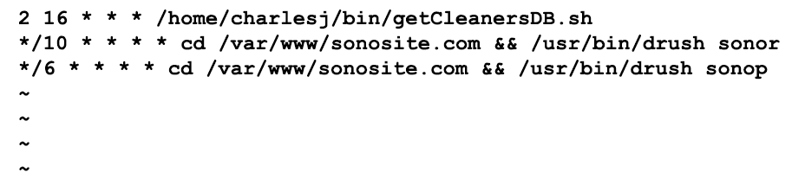
Automate Anything
crontab –e - Edit your cron table
Loads your cron table into the default editor (typically vi). Edit/Save to activate.

Slide 49
Automate Anything
The Five cron scheduling fields:
Field Allowed Values (* = wildcard)
minute 0-59
hour 0-23
day of month 1-31
month 1-12
day of week 0-7 (0 or 7 is Sun)
(Tip: man –s5 crontab will show this info, and much more!)

Slide 50
Just for Fun - figlet
Examples:
figlet Drupal Rocks
____ _ ____ _
| _ \ _ __ _ _ _ __ __ _| | | _ \ ___ ___| | _____
| | | | '__| | | | '_ \ / _` | | | |_) / _ \ / __| |/ / __|
| |_| | | | |_| | |_) | (_| | | | _ < (_) | (__| <\__ \
|____/|_| \__,_| .__/ \__,_|_| |_| \_\___/ \___|_|\_\___/
|_|
Redirect to a file:
figlet Development System > /etc/motd

Slide 51
Just for Fun - figlet
More fonts??
showfigfonts
shows all of them, with samples
figlet -f slant Too Cool
______ ______ __
/_ __/___ ____ / ____/___ ____ / /
/ / / __ \/ __ \ / / / __ \/ __ \/ /
/ / / /_/ / /_/ / / /___/ /_/ / /_/ / /
/_/ \____/\____/ \____/\____/\____/_/

Slide 52
Just for Fun - fortune
Example:
fortune
yo-yo, n.:
Something that is occasionally up
but normally down.
(see also Computer).

Slide 53
Just for Fun - cowsay
Example 1:
cowsay I LOVE this presentation
__________________________
< I LOVE this presentation >
--------------------------
\ ^__^
\ (oo)\_______
(__)\ )\/\
||----w |
|| ||

Slide 54
Just for Fun - cowsay
Example 2:
cowsay –f ghostbusters Who you gonna call?
____________________
< Who ya gonna call? >
--------------------
\
\
\ __---__
_- /--______
__--( / \ )XXXXXXXXXXX\v.
.-XXX( O O )XXXXXXXXXXXXXXX-
/XXX( U ) XXXXXXX\
/XXXXX( )--_ XXXXXXXXXXX\
/XXXXX/ ( O ) XXXXXX \XXXXX\
XXXXX/ / XXXXXX \__ \XXXXX
XXXXXX__/ XXXXXX \__---->
---___ XXX__/ XXXXXX \__ /
\- --__/ ___/\ XXXXXX / ___--/=
\-\ ___/ XXXXXX '--- XXXXXX
\-\/XXX\ XXXXXX /XXXXX
\XXXXXXXXX \ /XXXXX/
\XXXXXX > _/XXXXX/
\XXXXX--__/ __-- XXXX/
-XXXXXXXX--------------- XXXXXX-
\XXXXXXXXXXXXXXXXXXXXXXXXXX/
""VXXXXXXXXXXXXXXXXXXV""

Slide 55
Just for Fun - cowsay
Example 3:
fortune | cowsay
_______________________________________
/ One can search the brain with a \
| microscope and not find the mind, and |
| can search the stars with a telescope |
| and not find God. |
| |
\ -- J. Gustav White /
---------------------------------------
\ ^__^
\ (oo)\_______
(__)\ )\/\
||----w |
|| ||

Slide 56

Learning More . . .
man pages, "man" command
--help and –h and –usage flags
apropos (a hidden gem!)
and don't forget Google and Bing

Slide 57

Thank You
Happy and safe
Wizardry
Slides and sample code is available at
https://github.com/nightbeacons/Expecto_Patronum

Slide 58
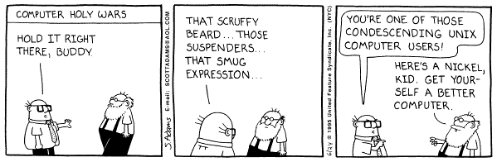
Charles Jackson
charles.jackson@fujifilm.com
Senior Web Manager
Fujifilm SonoSite

